Slide 1

Predicting Restaurants Closure

Slide 2
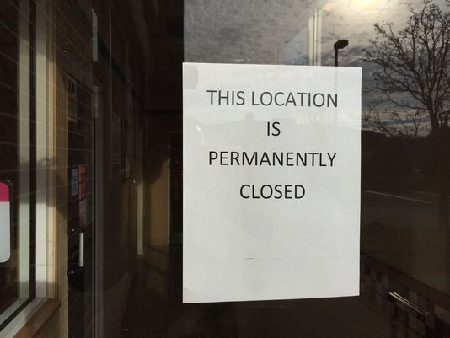

Slide 3





1)
Problem Statement
Predict restaurant closure
Who is Benefited?
Location
User Reviews
Banks can use this model to make informed loan decisions
Investors want to put their money on a restaurant that is likely to remain for many years.

Slide 4

2)
Gathering Data
5,200,000 user reviews,
Information on 174,000 businesses.
It spans 11 metropolitan areas

Slide 5
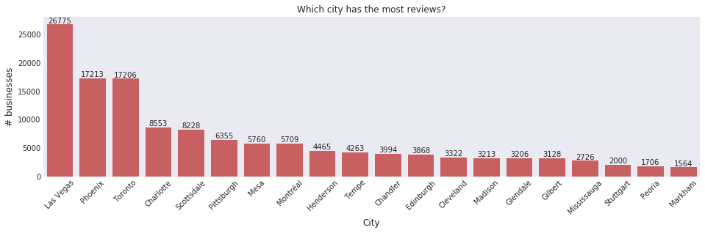
2)
Gathering Data

Slide 6
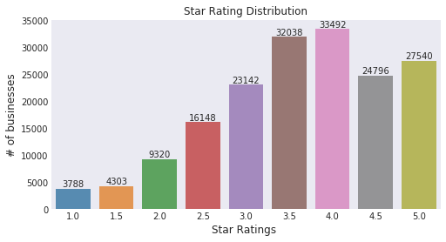
2)
Gathering Data

Slide 7
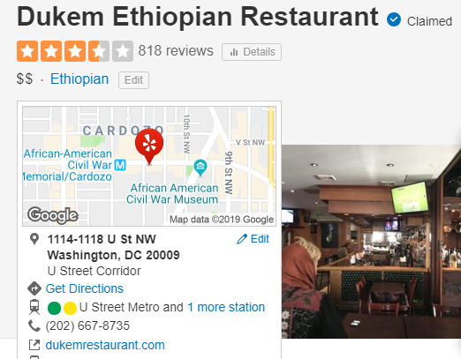
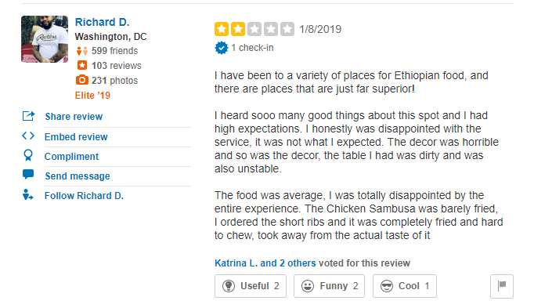
2)
Gathering Data
Restaurant
Reviews
name
stars
average stars
longitude
latitude
text
address
useful
funny
cool

Slide 8
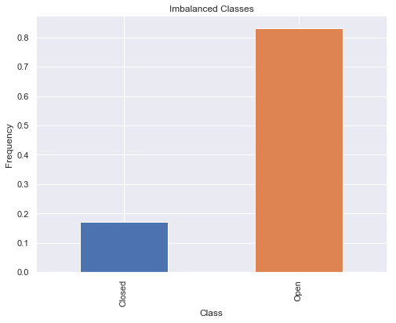
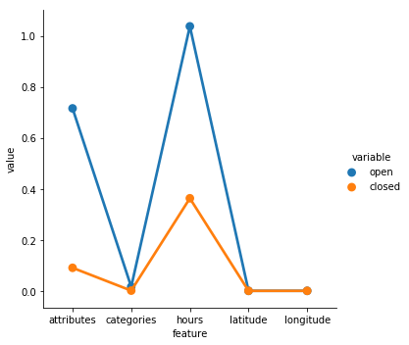
3)
Data Analysis
Closed Business contain lesser nulls
Huge Class Imbalance

Slide 9
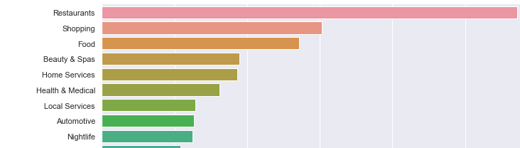
3)
Data Analysis
Restaurants Surpass Others

Slide 10
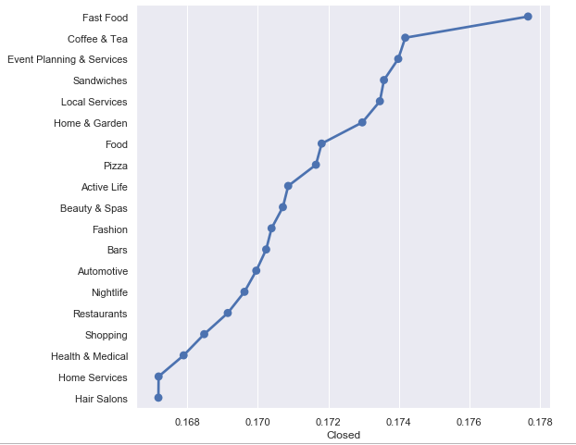
3)
Data Analysis
Closure Rate

Slide 11
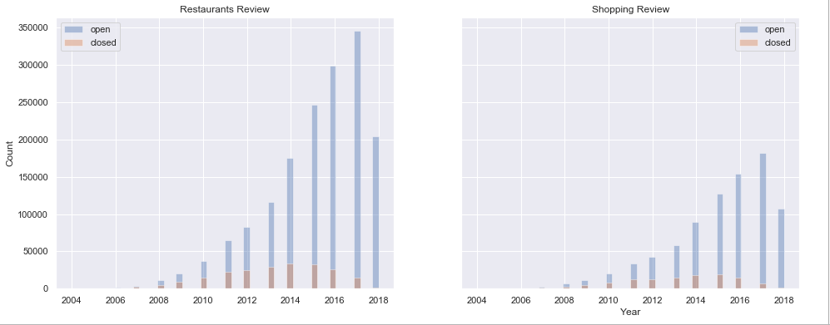
3)
Data Analysis
Number of Reviews by Year

Slide 12
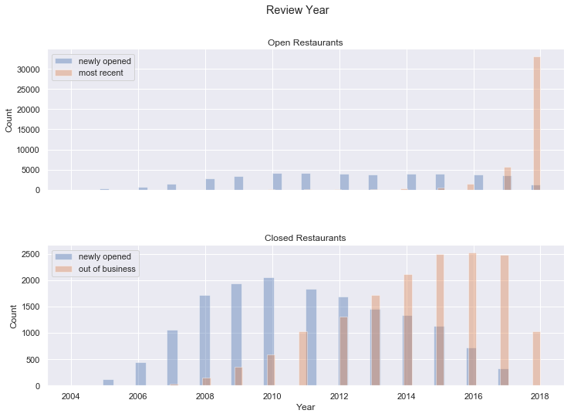
3)
Data Analysis
Most open restaurants received reviews this year
Many restaurants were closed in 2016

Slide 13
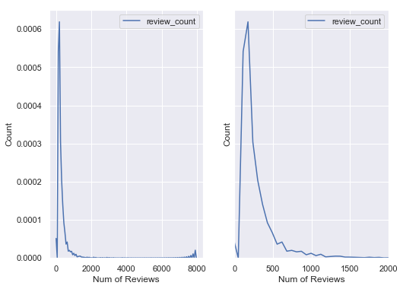
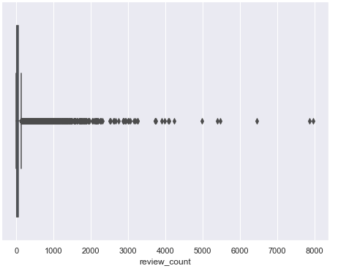
3)
Data Analysis
Outliers

Slide 14
4)
Feature Engineering
Age of a Restaurant
# num_of_reviews = 5e6, chunk_size = 1e6
for each chunk in chunks_of_reviews:
merge with businesses
group by business_id find the earliest year find the most recent year
append the years to a dataframe
using the dataframe
Find the earliest year for each business
Find the recent year for each business age = 2018 - earliest_review _ year
 | is_open | average_stars | review_count | latitude | longitude | age_of_restaurant
0 | 1 | 4.0 | 24 | 51.049673 | -114.079977 | 2
1 | 1 | 3.0 | 39 | 43.840905 | -79.399604 | 10
2 | 1 | 3.5 | 45 | 43.677807 | -79.444674 | 6

Slide 15


4)
Feature Engineering
Bag of Words
Bag of Words Per Business
# num_of_reviews = 5e6 # chunk_size = 1e6
for each chunk in chunks_of_reviews:
merge with businesses
apply CountVectorizer to review_text
save the data
# I used only one chunk
# due to memory limitation
dict = distinct business ids : indices of reviews
for each business_id in dict_keys:
indices = dict [dict_keys]
find the average word count
append data
There are 56387 restaurants
An average of 47505 businesses in each chunk have review
Sparse Matrices

Slide 16

4)
Feature Engineering
Sparse + Dense
Train/Test Split
The train-test split is done before any feature transformation that uses all data to prevent data leakage
47490 x 3994 sparse matrix
47490 x 6 dense matrix
Pipelines can apply all transformations across folds
47490 x 3999 sparse matrix
A pipeline can be used to transform train set and test set separately
There are 56387 restaurants
An average of 47505 businesses in each chunk have review

Slide 17

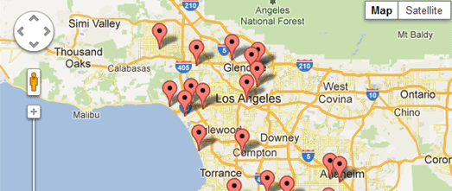
4)
Feature Engineering
Distance Features
Scaling and Normalizing
Adopted GeoPy’s great_circle method to work in a vectorized way
Removed Longitude and Latitude because they are correlated with many features
Nearest Average Number of Reviews
StandardScaler: distance_features , average stars, review_count, age
Nearest Average Rating
Normalizer: bag of words (3994)

Slide 18
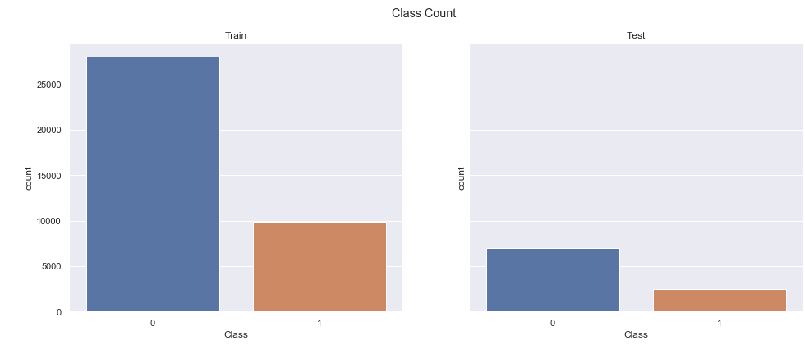
4)
Feature Engineering
Class Imbalance

Slide 19
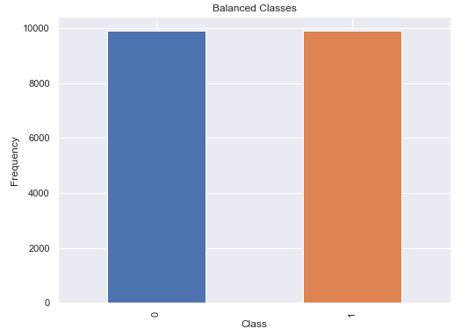
4)
Feature Engineering
Under sampled
Pipeline
(
[
('DFC’,
DistanceFeaturesCreator()),
('imputer’, SimpleImputer(strategy="mean")),
("scale-normalize",
CustomNormalizer())
]
)

Slide 20
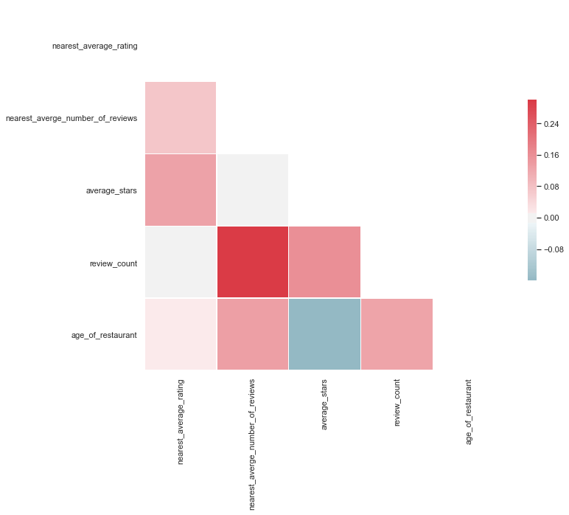

Slide 21
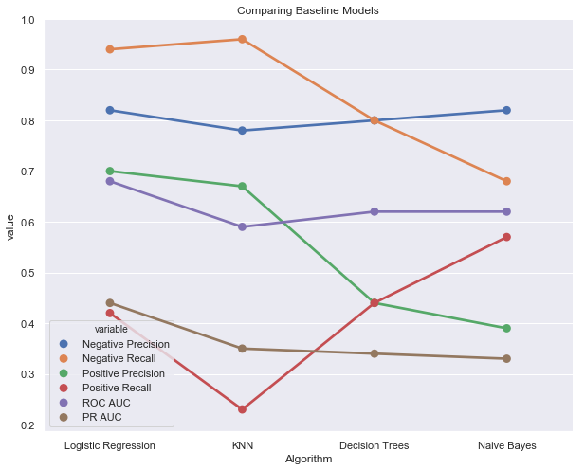
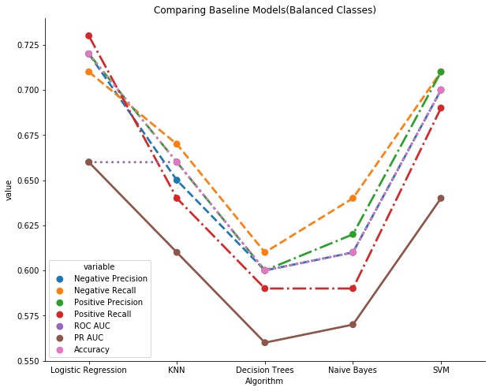
4)
Baseline Modeling
Unbalanced Dataset
Balanced Dataset

Slide 22
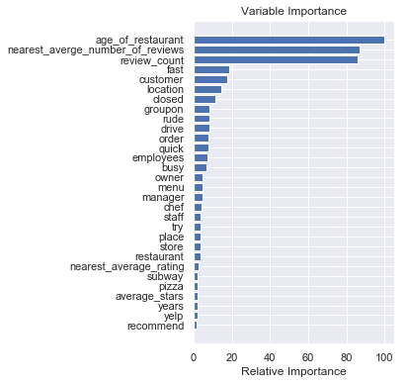
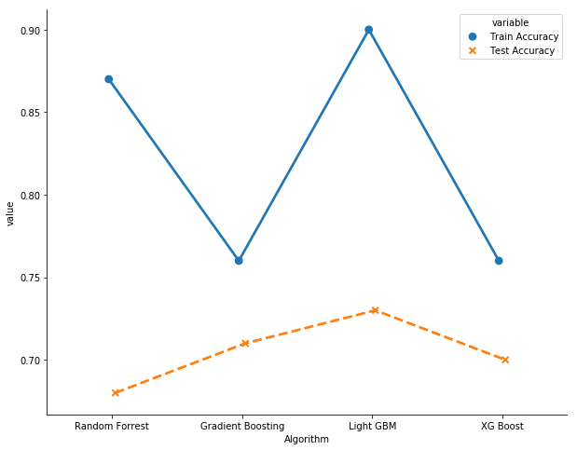
4)
Secondary Modeling
Comparing Train/Test Accuracy
XG-Boost

Slide 23
4)
Hyperparameter Tuning
Logistic Regression
Final Model
Best parameter (CV score=0.714):
{
'C': 1.25,
penalty': 'l2’
}
0.723

Slide 24
4)
Hyperparameter Tuning
LightGBM
Best parameter
(CV score = 0.716)
'bagging_fraction': 0.7
'bagging_freq': 10
'boosting_type': 'gbdt’
'feature_fraction': 0.6
'learning_rate': 0.01
'max_bin': 300
'max_depth': 20
'metric': 'binary_error’
'min_data_in_leaf': 50
'n_estimators': 100
'num_leaves': 100
'objective': 'binary’
'reg_alpha': 1.2,
'reg_lambda': 1.2
'subsample': 0.6
Overfitting Decreased !!
Training Score: 0.79
Testing Score: 0.71

Slide 25
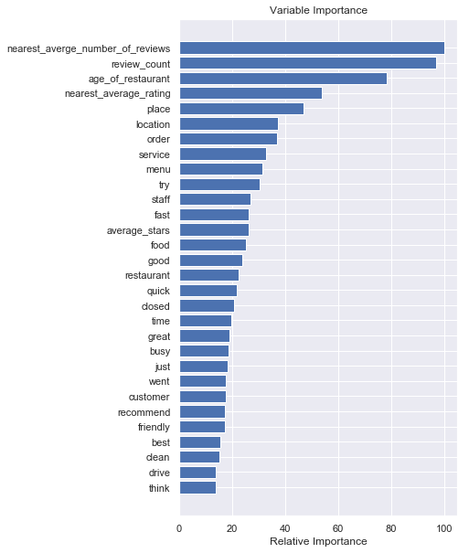
4)
Hyperparameter Tuning

Slide 26
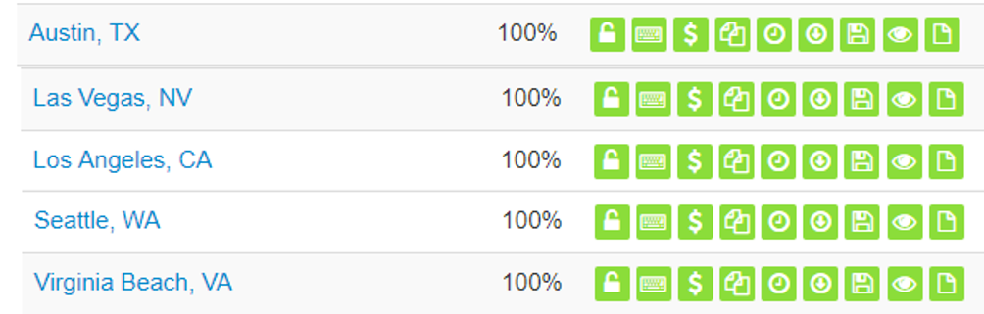
4)
Future Work
The 11 metropolitan areas, which are used in the Yelp public dataset, don’t have complete health inspection data
Getting more data about any city is possible by scraping the website or contacting them.
Health Inspection Data is publicly available for many cities
I tried to merge health inspection data of Las Vegas with Nevada restaurants on Yelp Dataset.
Found only 1000 restaurants

Slide 27
5)
Future Work
Use more data and do more hyperparameter tuning using high performance computer
Do advanced NLP techniques

